Slide 1
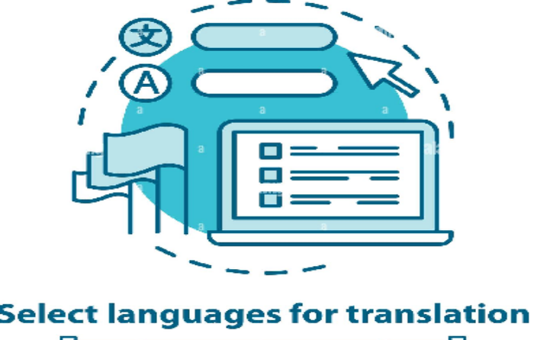
Unit 5.2 - Language Translators
Prepared by: Koh Kian Hua

Slide 2
Objectives
After completing this unit, students should be able to:
Show understanding of the need of an assembler software for the translation of an assembly language program.
Show understanding of the need of a compiler for the translation of a high-level language program.
Show understanding of the need of an interpreter for translation and execution of a high-level language program.
Explain the benefits and drawbacks of using either a compiler or interpreter and justify the use of each.
Show awareness that high-level language programs may be partially compiled and partially interpreted, such as Java.
Describe features found in a typical Integrated Development Environment (IDE).

Slide 3
Language Translators
Translation and Execution of Programs
Programming instructions written in any programming language other than machine code must be translated before they can be used.
A software program that is used to translate a source program written in any language is known as tranlators.
There are three types of translator available, and each performs a different role.
  Assemblers
  Compilers
  Intepreters

Slide 4
Language Translators
Assemblers
Programs written in assembly language can be translated into machine code by an assembler program.
Assemblers can store the program directly:
  in main memory as it is translated,
  or store the translated program on a storage medium to be used later.
If the program is stored for later use;
  a loader program is needed to load the stored translated program into main memory before it can be executed.
  the stored translated program can be executed many times without being re-translated.

Slide 5
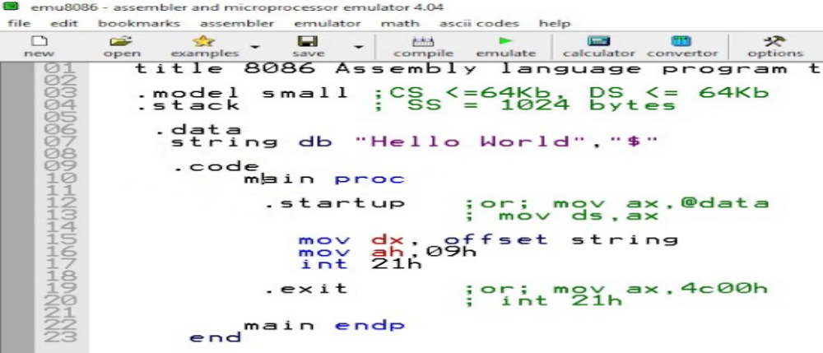
Language Translators
Assemblers
Every different type of computer/chip has its own machine code and assembly language.
Assembly language programs are machine dependent; they are not portable from one type of computer/chip to another.
8086 Assembly Program to Display "Hello World" on Screen

Slide 6
Language Translators
Compiles and Interpretors
Programs written in a high-level language can be either
  translated into machine code by a compiler program,
  directly executed line-by-line using an interpreter program.
Compilers usually store the translated program (object program) on a storage medium ready to be executed later.
The stored translated program needs to be loaded into main memory before it can be executed.
  the program can be executed many times without being retranslated.
  the program only needs to be retranslated when changes are made to the source code.
With an interpreter, no translated program is generated in main memory. Every line in a program is interpreted then executed each time the program is run.
High-level language programs are machine independent, and can run on any type of computer/chip, provided there is a compiler or interpreter available.

Slide 7
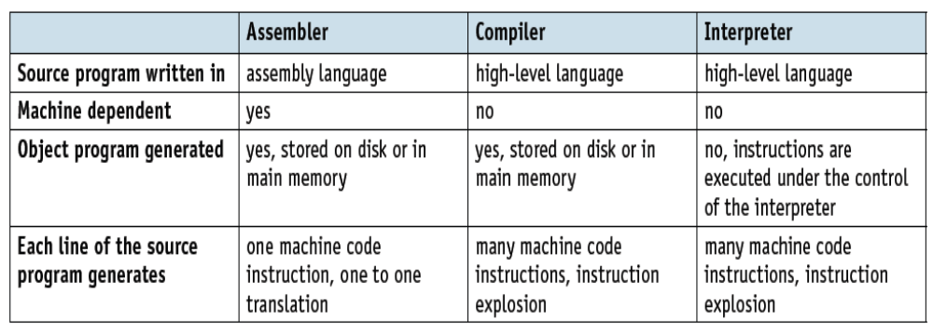
Language Translators
Compiles and Interpretors
Similarities and differences between Assemblers, Compiler and Interpreters are as follows:

Slide 8
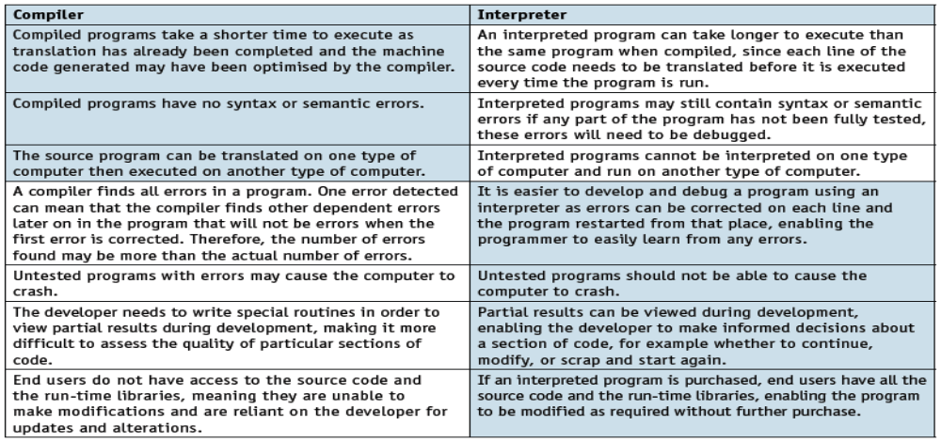
Language Translators
Pros and Compiles and Interpretors
The pros (in the blue cell) and cons (in the white cells) of compilers and interpreters:

Slide 9
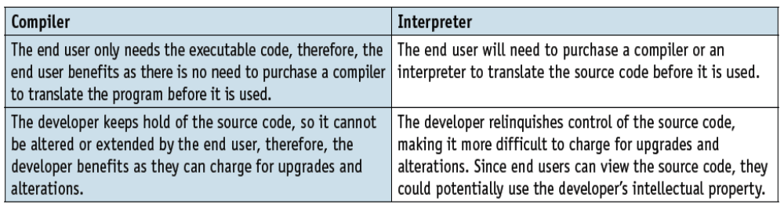
Language Translators
Pros and Compiles and Interpretors
Both compilers and interpreters are used for programs written in high-level languages.
Some integrated development environments (IDEs) have both available for programmers.
The pros (in the blue cell) and cons (in the white cells) of compilers and interpreters:

Slide 10
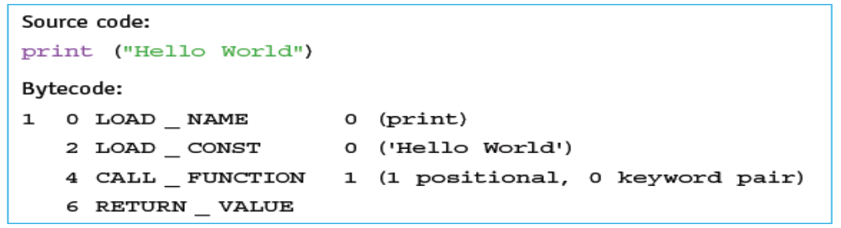
Language Translators
Partial Compiling and Interpreting
To achieve shorter run times, many high-level languages programs use a system that is partially compilation and partially interpretation.
  The source code is checked and translated by a compiler into object code.
  The compiled object code is a low-level machine independent code, called intermediate code, p-code or bytecode.
  To execute the program, the object code can be interpreted by an interpreter or compiled using a compiler.
  Example of Python intermediate code (bytecode):

Slide 11
Language Translators
Integrated Development Environment (IDE)
An integrated development environment (IDE) is used by programmers to aid the writing and development of programs.
There are many different IDEs and some of these includes:
  NetBeans®,
  PyCharm®,
  Visual Studio®
  SharpDevelop

Slide 12
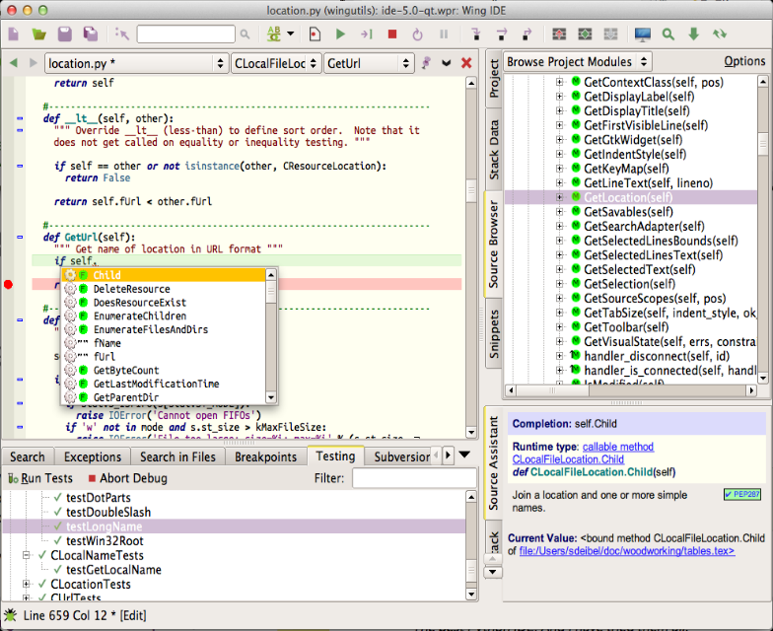
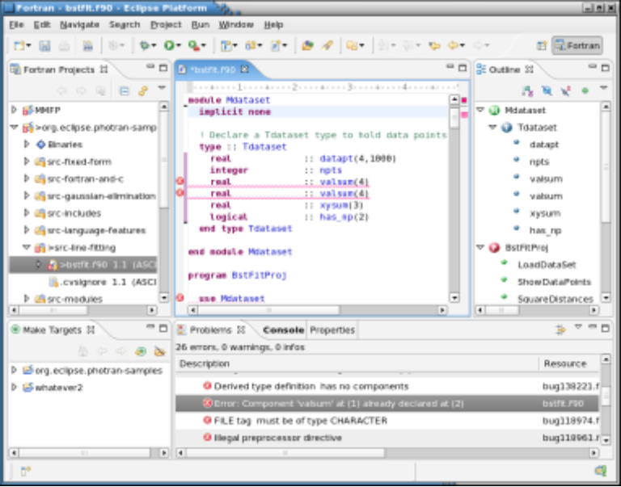
Language Translators
Integrated Development Environment (IDE)
Screenshots of IDEs
ECLIPSE IDE for Java Programming
WINGS IDE for Python Programming

Slide 13
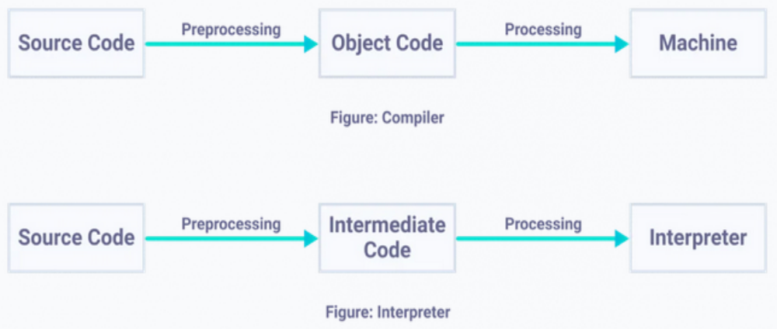
Language Translators
Integrated Development Environment (IDE)
Compilers and Interpreters: are used to convert a program written in a high-level language into machine code understood by computers.
The interpreter is often used for developing the program and the compiler to produce the final version of the object code.

Slide 14
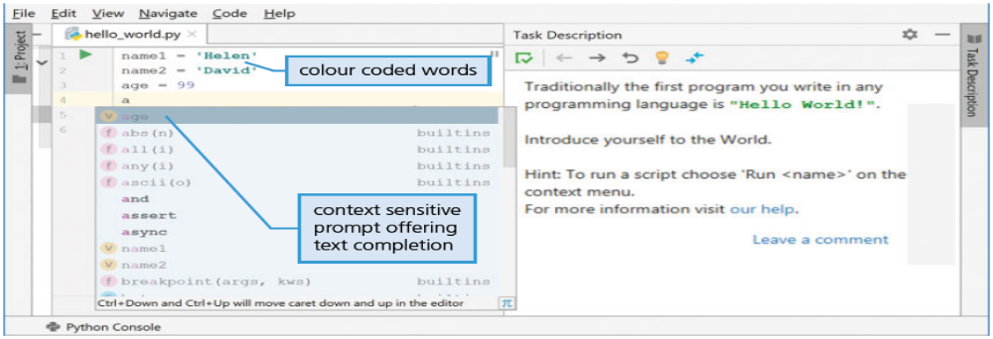
Language Translators
Integrated Development Environment (IDE)
Source Code Editor: allows a program to be written and edited without the need to use a separate text editor.
  source code editors help to speeds up the development process.
  source code editors colour code the words in the program and
  layout the program in a meaningful way (prettyprinting)
  Dynamic syntax checking finds possible syntax errors
  Screenshot of PyCharm (Python) IDE source code editor

Slide 15
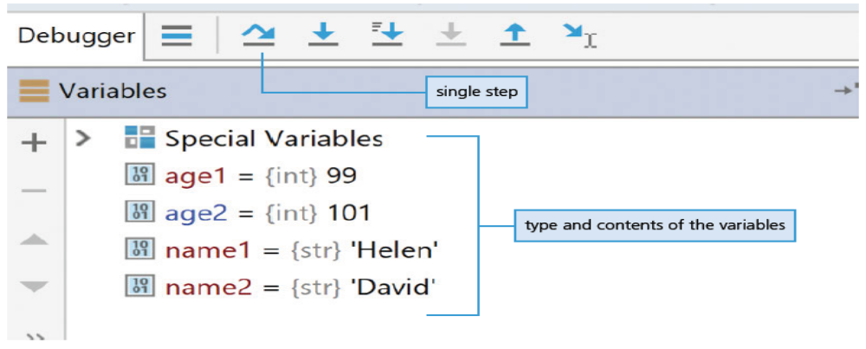
Language Translators
Integrated Development Environment (IDE)
The Debugger: a program that runs the program source code under development and aids the process of debugging.
  it allows the programmer to single step through the program a line at a time (single stepping)
  it allows the programmer to set a breakpoint to stop the execution of the program at a certain point in the source code.
  Screenshot of PsyCharm Python IDE Debugger

Slide 16
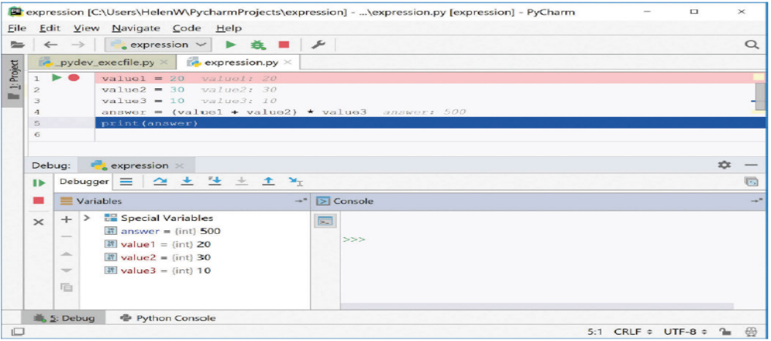
Language Translators
Integrated Development Environment (IDE)
Report Window: shows the contents of the variables and expressions evaluated at that point in the program.
  it allows the programmer to see if there are any logic errors in the program and check that the program works as intended.
  Screenshot of PsyCharm Python IDE Report Window

Slide 17
Language Translators
Class Activity
Find out the different IDEs that are available and identify which programming languages are supported.
List some of the common or unique features of these IDEs that you have identified.

